Slide 1
PromptToStableDiffusion
Optimizing prompting and text-to-image generation at the same time
Blake Wang, Vicky Yue
Notes:
In this project we try to Optimizing prompting and text-to-image generation at the same time and see if they can enhance each other

Slide 2
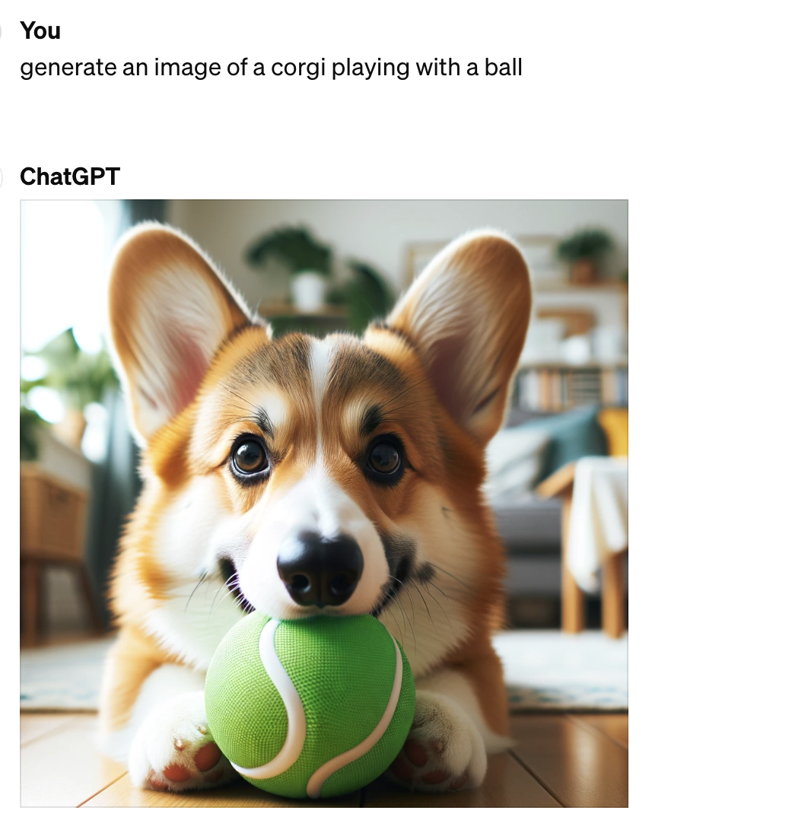
Background
When you wrote....
Notes:
For us, text to image generation has no secrets. But for a common user without a CS background, providing a good prompt could be challenging. For example, this is what a common user might write when they try to generate an image for their dog. But is this really what they want?

Slide 3
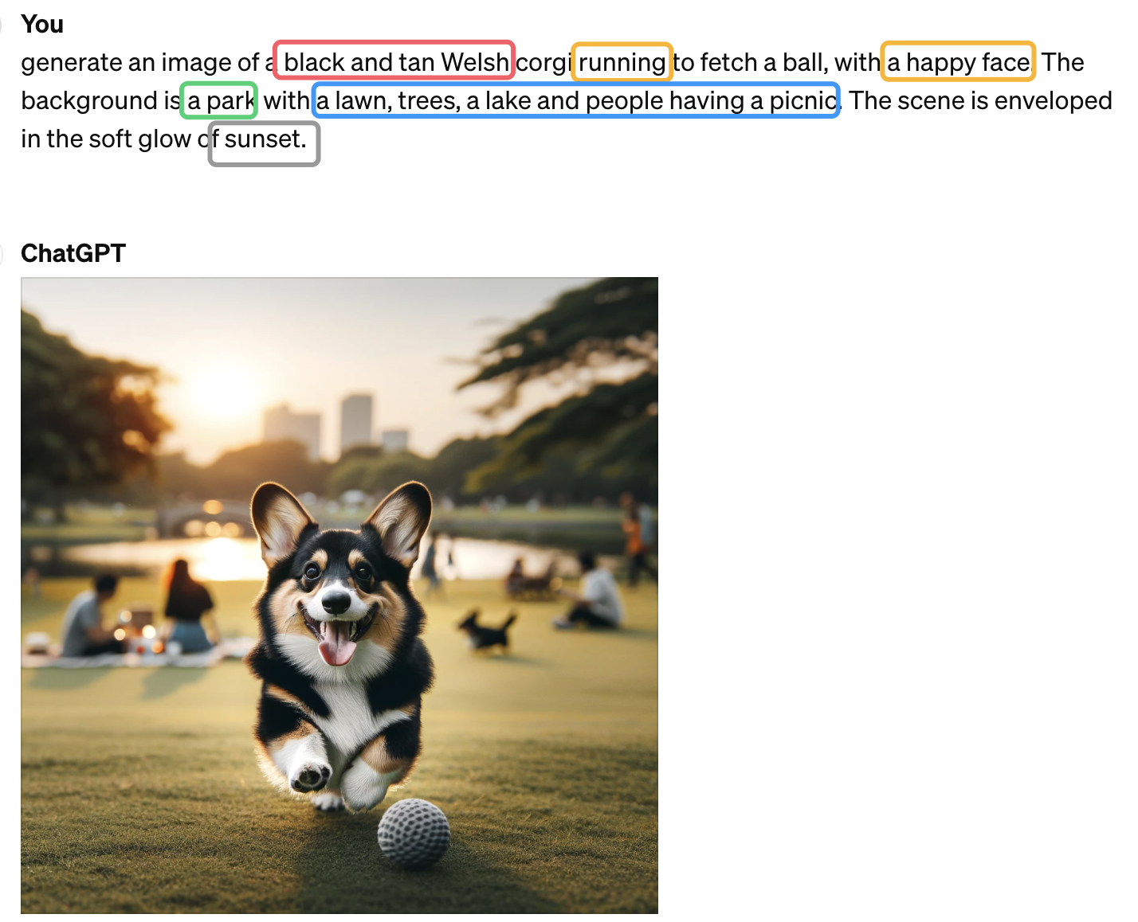
Background
Did you actually mean…?
When you wrote....
Notes:
Actually, they might want much more! Their dog might be black and tan, instead of yellow, and they might want the background be a park, which is more probable than playing in the bedroom. They also want better details like lake, trees and sunset. So here comes the question: how can we help untrained common people to generate image with better quality and details?

Slide 4
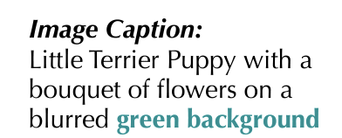
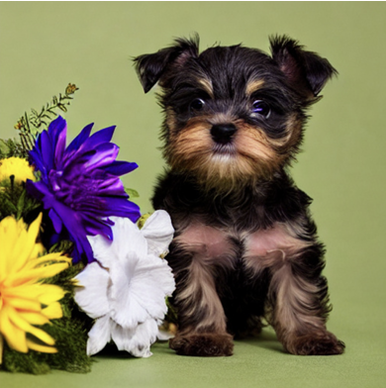
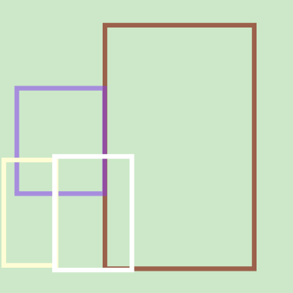
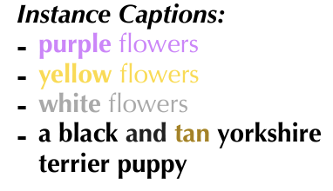
Background
SOTA models are already using this technique!
InstanceDiffusion: Instance-level Control for Image Generation, arxiv 2402.03290
Notes:
We researched different techniques to do achieve this and we found that there are mainly 2 ways to do this. The first way is demonstrated by INstanceDiff, where we first analyze the image caption and break it down into several instance captions. For example here, a bouquet of flowers become purple flowers, yellow flowers and white flowers in the instance caption, and the puppy became a black and tan yorkshire puppy. Then we predict bounding boxes for each instance and generate them separately, and finally combine them to get the final output.

Slide 5
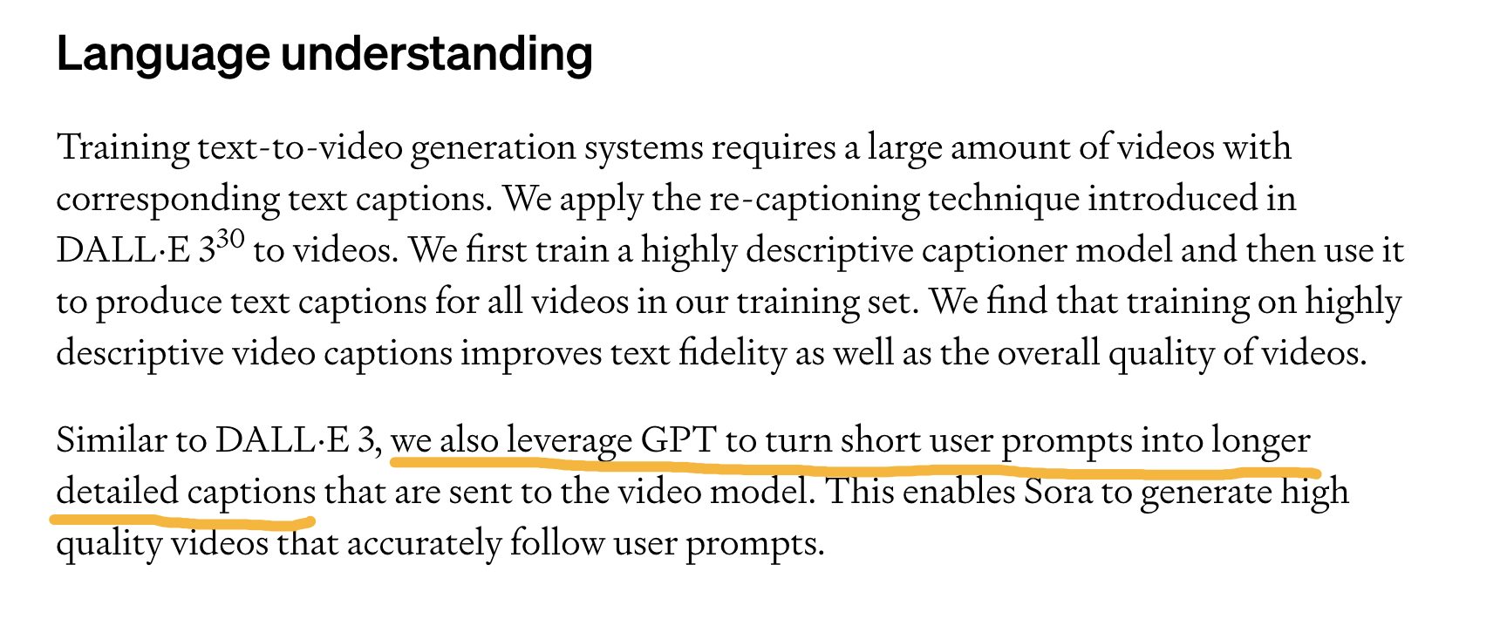
Background
SOTA models are already using this technique!
https://openai.com/research/video-generation-models-as-world-simulators
Notes:
Another way, which is used by openAI, is much more straightforward. For openAI’s DALLE and Sora, which is their image and video generation model, the claim to use chatGPT to …. And this is the technique we are interested in.

Slide 6
Background
We aim to answer the following questions:
Can prompting techniques help improve image generation quality?
Can we use (improved prompting, image) pairs to in turn improve text-to-image generation models?

Slide 7
Approach: Improve Prompting
Color/type of the object
an orange Siamese cat
Posture, action and expression of the creature
a baby lying on the floor, crying
Place of object, spatial relationship between the objects
a cat is sitting next to the dog
Atmospheric details, lighting and time of day
a misty morning atmosphere
Add background elements
pizza -> pizza served with a wine glass on the side, on a dining table
Final check

Slide 8
Approach: Improve Prompting
Color/type of the object
Posture, action and expression
Spatial relationship between the objects
Atmospheric details, lighting and time of day
Add background elements

Slide 9
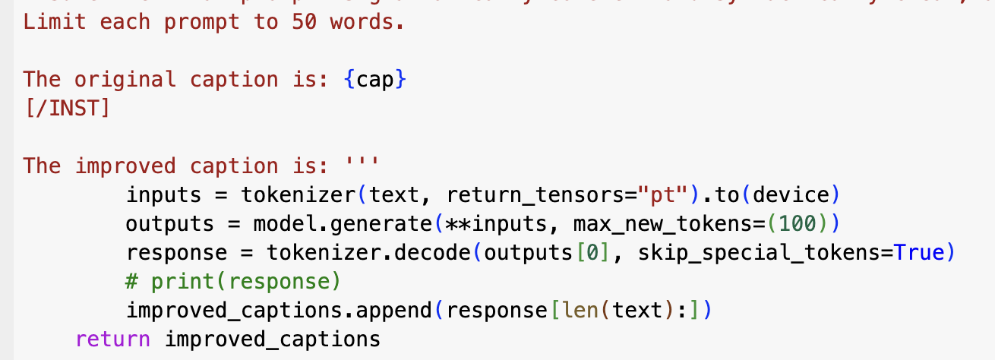
Approach: Improve Prompting
We use Mistral-7B-Instruct for batch generation of improved prompts(for free), but use GPT-4 for a small set of evaluation for best results.

Slide 10
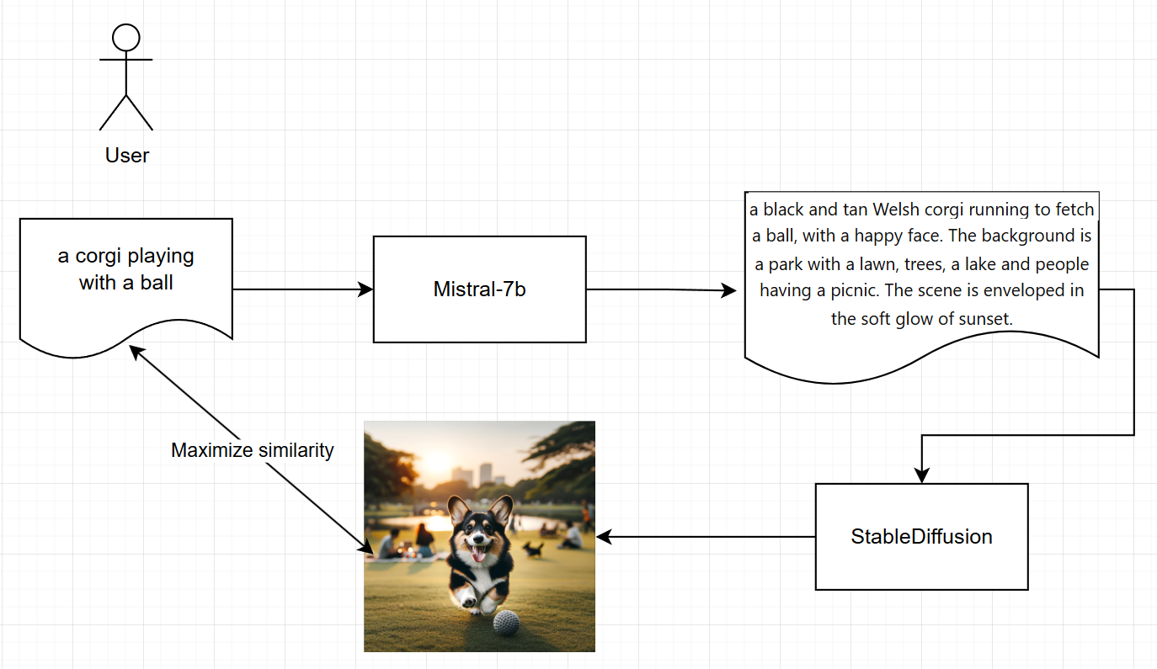
Approach: Training
We use StableDiffusion 1.5 as our baseline model.
We train on a small subset of COCO 2017 dataset.
We train on improved_image
But we evaluate on (original_caption, improved_image) pairs
Why?

Slide 11
Approach: Training
We evaluate on (original_caption, improved_image) pairs
Why?
In a real application, user need not to know how to optimize prompts!
User gets detailed image with simple prompts with our solution

Slide 12
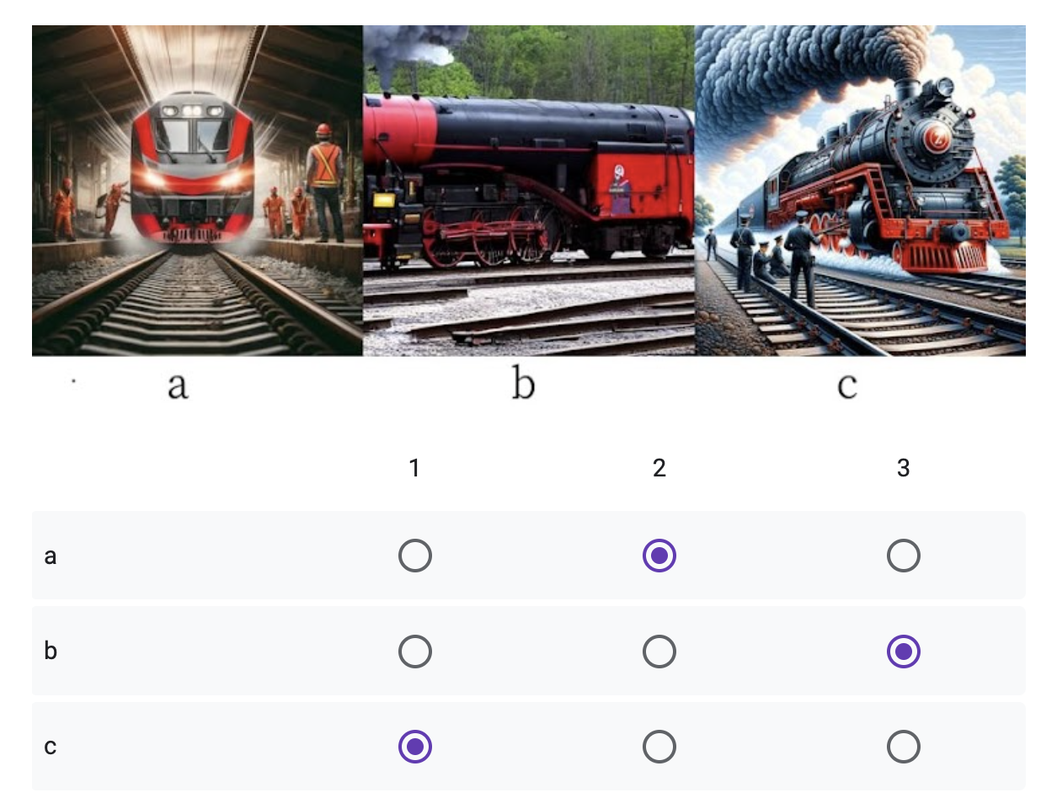
Approach: Evaluation
We evaluate on CLIP score of (original_caption, improved_image) pairs vs. original image
We also use human evaluation: rank the following images based on the text prompt
1 image by StableDiff + improved prompt
1 image by DALL-E + original prompt
1 image by DALL-E + improved prompt
We ask GPT to generate image “exactly” on our prompt to avoid DALL-E’s automatic prompt improvement
Notes:
For evaluation, we are using CLIP score of original_caption and improved_image pair vs the original image.
We also gave out some questionnaire for human evaluation. We ask people to rank three images from high to low. They are generated by different models or different prompts. And they are randomly sorted in order to reduce possible bias. Since GPT uses dall-E to generate image, we ask gpt not to any add improvements to affect the truth quality of the image.

Slide 13
Approach: Evaluation
human evaluation: rank the following images based on the text prompt
StableDiff + improved prompt(ours) vs DALL-E + original prompt
Can our solution beat other advanced models?
DALL-E + original prompt vs DALL-E + improved prompt
Can our prompting technique improve other model’s performance?
Notes:
We are mainly looking at two aspects from human evaluation. First we want to compare our model to the dall-E original prompt to see if our model or the prompt improvement idea is on the right track
We also want to see if the difference in prompt provides us improves to model’s performance for the same model.

Slide 14
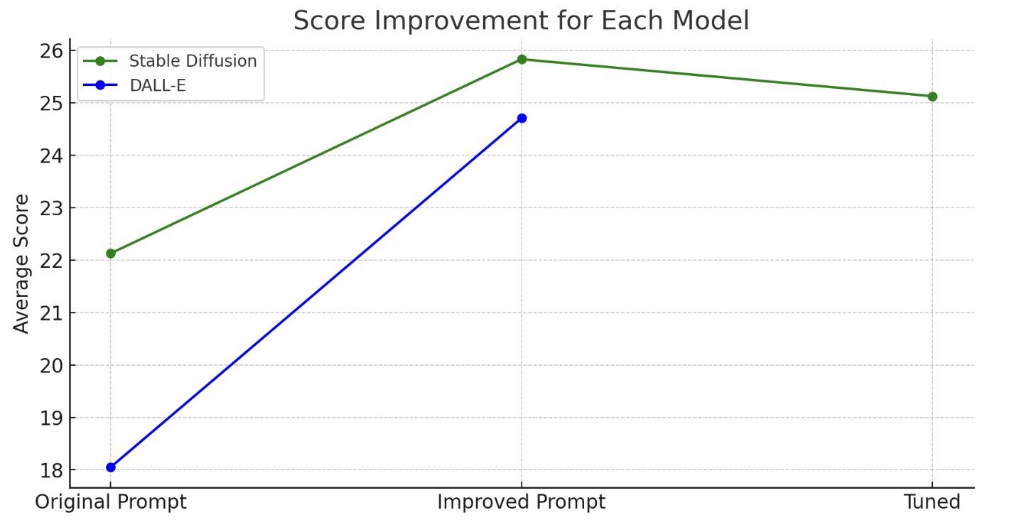
Results
Model | Original Avg score | Improved Avg score | Improvement
Stable Diffusion | 22.13 | 25.83 | +16.74%
DALL-E | 18.05 | 24.70 | +36.84%
Notes:
We've been tracking the average CLIP scores of these models as a benchmark for their output quality. For Stable Diffusion, we've seen an improvement from an original average score of 22.125 to 25.828125. This represents an increase of over 16%, a testament to our optimization strategies and training enhancements.
Moving on to DALL-E, which initially had an average score of 18.046875, we've successfully boosted this to 24.703125. That’s an impressive leap of nearly 37%, highlighting our focused efforts on refining the model's ability to generate high-fidelity images.
After tuning, our clip score doesn’t have big improvement since we are unable to get a huge dataset.

Slide 15
Results
56%
47%
evaluators preferred Stable Diffusion + improved
vs. DALL-E + original
evaluators preferred improved prompt
vs. original prompt on DALL-E
Notes:
These percentages shows us the result for the questionnaire. From the percentage we mean that, among all the results that we received, stable diffusion + improved beats dall-E + original 56% of the time, meaning that our solution has a higher rank than dall-E + original. We’re really happy that people prefer image generated from our model
For dall-E, we can see that people think images generated by the original prompt is better than the image generated by improved prompt. Our suspect is that dall-E still auto enhanced our prompt even when we told it not to. Sometimes the image become overly detailed if the dall-E enhanced the improved prompt.

Slide 16
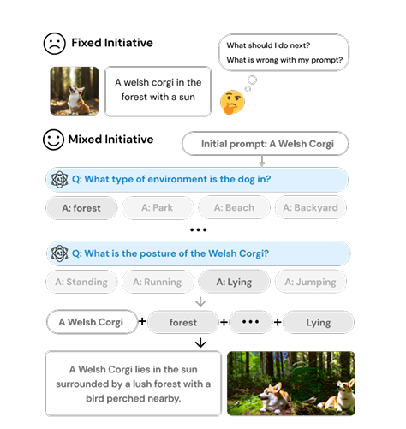
Future Work
Mixed initiative - assists the user to provide more details for a better prompt
PromptCrafter: Crafting Text-to-Image Prompt through Mixed-Initiative Dialogue with LLM, arxiv 2307.08985.
Notes:
Looking ahead, we aim to further refine these techniques. Mixed-initiative systems will be crucial for assisting users in generating detailed prompts, thereby enhancing the overall quality and applicability of generated images.
In this example, we can see that if we have fixed initiative, user won’t know how to enhance their prompt or what to expect. If we use mixed initiative, the user can input the desired feature for better generation.

Slide 17
References
Sora Technical Report: Video generation models as world simulators, https://openai.com/research/video-generation-models-as-world-simulators.
InstanceDiffusion: Instance-level Control for Image Generation, arxiv 2402.03290.
PromptCrafter: Crafting Text-to-Image Prompt through Mixed-Initiative Dialogue with LLM, arxiv 2307.08985.
Optimizing Prompts for Text-to-Image Generation, arxiv 2212.09611.
Improving Text-to-Image Consistency via Automatic Prompt Optimization, arxiv 2403.17804

Slide 18
THANK YOU
Notes:
For this part, we are looking at the results that we received. From the percentage we mean that, among all the results that we received, stable diffusion + improved beats dall-E + improved 56% of the time, meaning that it has a higher rank than dall-E + improved. We’re really happy that people prefer image generated from our model
For dall-E, we can see that people think images generated by the original prompt is better than the image generated by improved prompt. Our suspect is that dall-E still enhanced our prompt even when we told it not to. Sometimes the image become overly detailed if the dall-E enhanced the improved prompt.

